Slide 1
Enterprise Code Indexing & Search Roadmap
Multi-Tenant • Snapshot→MinIO • Incremental • Ops Add-on

Slide 2
Where we are today
✅ Working prototype:
Single-tenant, single branch (main/master)
Git clone → index → delete local
Embeddings in Milvus, graph in Neo4j, metadata in Postgres
Search returns relevant chunks of code across repos
Demo focus: semantic + graph search already working

Slide 3
Challenges / Gaps
Re-indexing = slow (full rebuild every time)
No tenant isolation (scoping to domains/teams)
Limited scalability (one worker at a time)
Ops troubleshooting not yet supported (logs, stack traces)

Slide 4
Roadmap: Next Milestones
Phase 1: Multi-Tenant Support
- Tenant key = domain//region/team
- Partitioning in Milvus/Neo4j/MinIO
- Scoped searches & ACL enforcement
Phase 2: Option B Snapshot → MinIO
- One snapshot job → tar+manifest in MinIO
- Many shard jobs stream from MinIO
- No shared filesystem, scalable across workers
Phase 3: Incremental Indexing
- Track last_indexed_commit
- Only index ADDED/MODIFIED files; delete stale
- /index = incremental; /reindex = full
Phase 4: Ops Troubleshooting Add-on
- Log template embeddings + route mappings
- /search/log maps Splunk logs or stack traces → code
- Graph expansion for blast radius analysis

Slide 5
Use Cases
1. Developers waste time finding code across repos
→ Focus on mainline code (currently shipped).
2. Reviewers need context in MRs
→ MR diffs are against main (or develop).
→ Index main branch, pull changed files, ask: 'what does this touch?'
3. New engineers onboarding ('Where is JWT validated?')
→ They care about the current source of truth (main branch).
4. Splunk issues → code
→ Prod issues map to deployed version (main or release branch).

Slide 6
Benefits
Developers: faster cross-repo code search
Reviewers: context on method impact
New engineers: onboarding Q&A
Ops teams: map Splunk issues to exact methods & dependencies
Enterprise: secure, scalable, stateless token model

Slide 7
Next Steps
Align infra (Postgres, Milvus, Neo4j, MinIO) on K8s
Start with Phase 1 + Phase 2 → multi-tenant + snapshot fan-out
Add incremental diffs for performance
Deliver ops add-on for production support in Q2

Slide 8
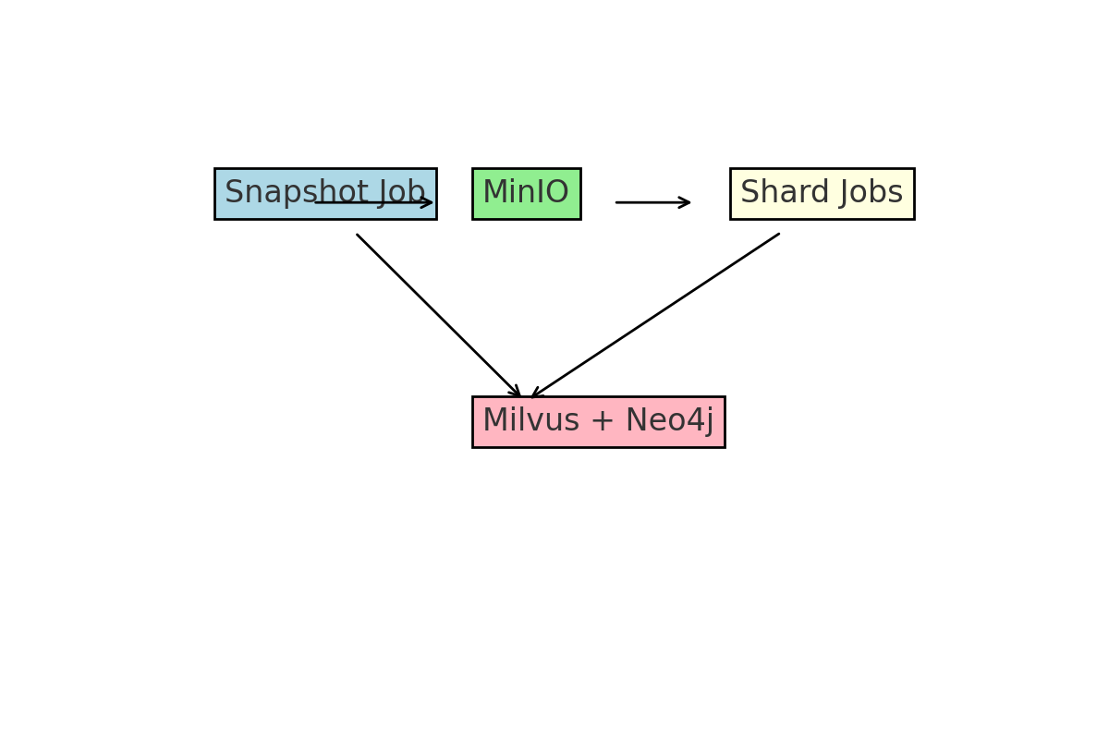
Indexing Flow

Slide 9
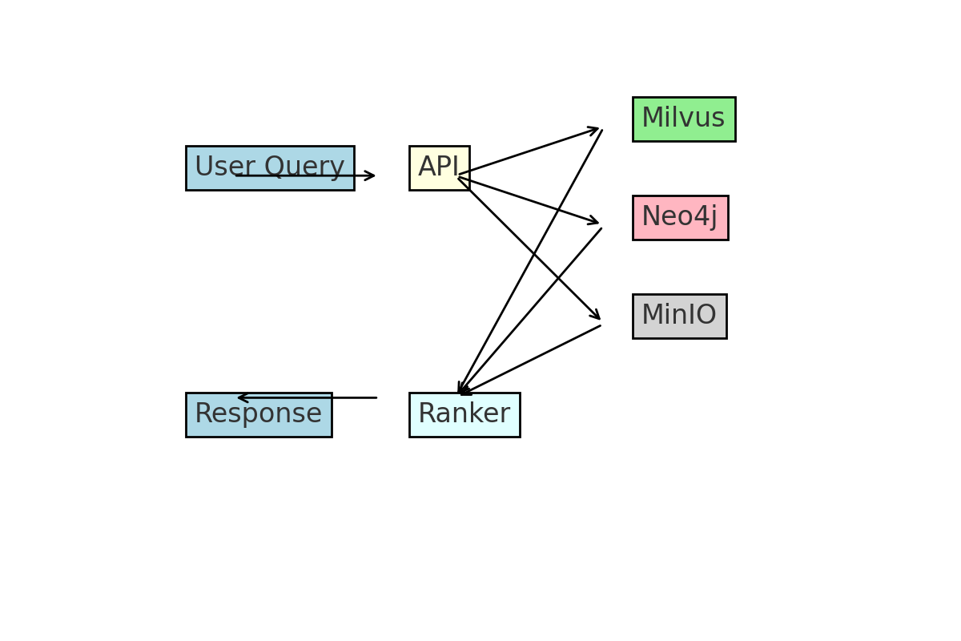
Search Flow

Slide 10
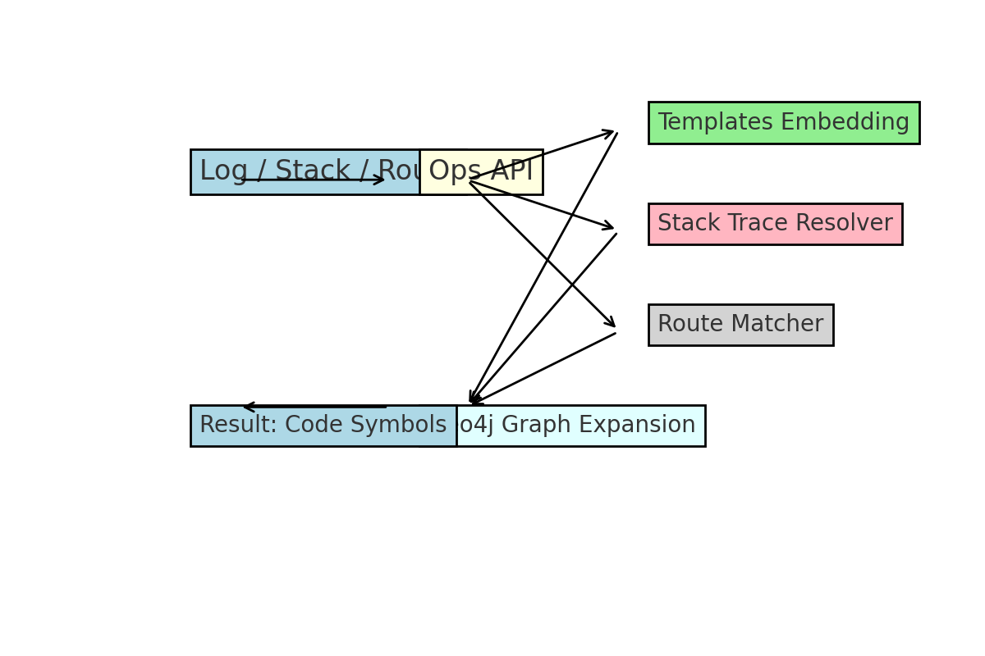
Ops Troubleshooting Flow

